Slide 1
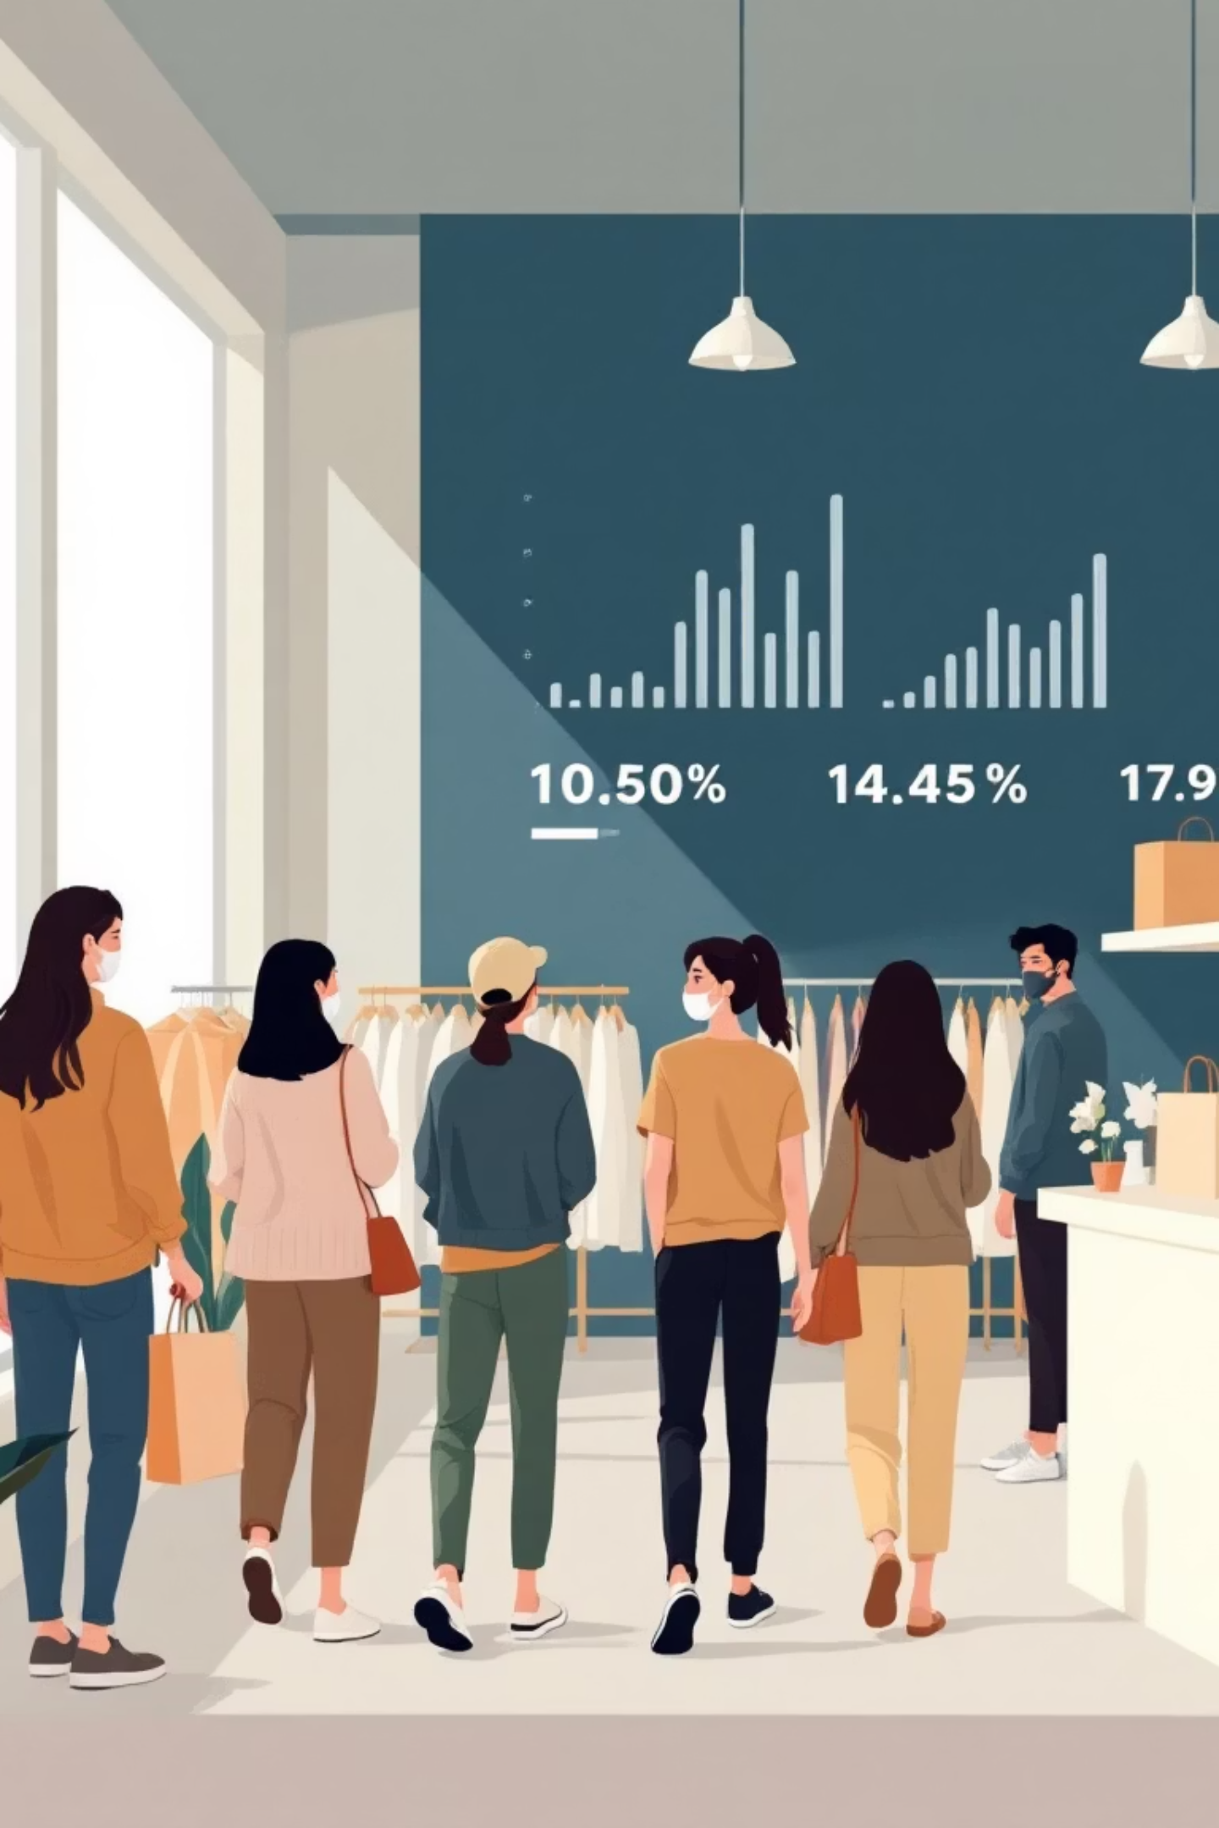
Customer Shopping Behavior Analysis
Uncovering insights from transactional data to guide strategic business decisions.

Slide 2

Project Overview & Dataset Summary
Project Goal
Analyze 3,900 purchases to understand spending, segments, preferences, and subscriptions.
Key Features
Customer demographics
Purchase details
Shopping behavior
Dataset Snapshot
3,900 Rows, 18 Columns
Missing data: 37 values in Review Rating

Slide 3
Exploratory Data Analysis (Python)
01
02
Data Loading & Exploration
Missing Data Handling
Imported with `pandas`, checked structure and statistics.
Imputed `Review Rating` using median by product category.
03
04
Column Standardization
Feature Engineering
Renamed columns to `snake_case` for readability.
Created `age_group` and `purchase_frequency_days`.
05
06
Data Consistency
Database Integration
Dropped redundant `promo_code_used` column.
Loaded cleaned data into PostgreSQL for SQL analysis.

Slide 4
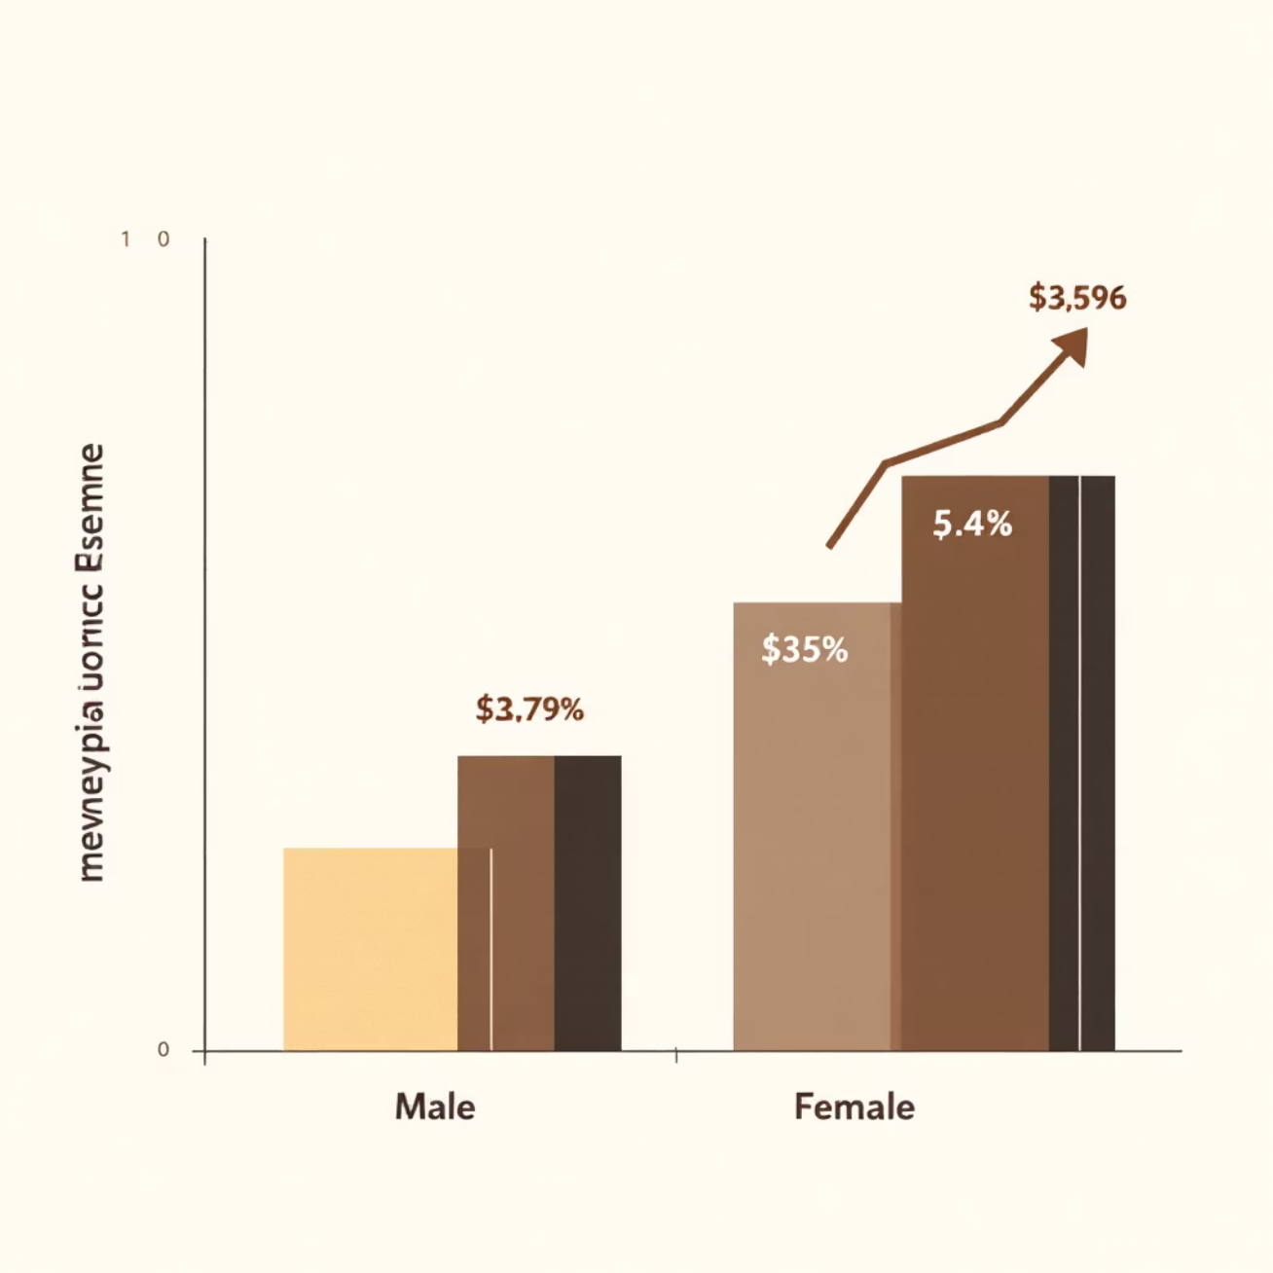
Data Analysis (SQL) - Key Insights
Revenue by Gender
Female: $75,191
Male: $157,890
Top 5 Products by Rating
Gloves: 3.86
Sandals: 3.84
Boots: 3.82
Shipping Type Comparison
Standard: $58.46 avg.
Express: $60.48 avg.
Subscribers vs. Non-Subscribers
Avg. spend similar, non-subscribers higher total revenue.

Slide 5

SQL Analysis - Customer & Product Focus
High-Spending Discount Users
Discount-Dependent Products
Identified 839 customers who used discounts but spent above average.
Hat, Sneakers, Coat, Sweater, Pants have highest discount rates.
Customer Segmentation
Top Products per Category
Loyal (3116), Returning (701), New (83) segments identified.
Jewelry (Accessories), Blouse (Clothing), Sandals (Footwear), Jacket (Outerwear).

Slide 6
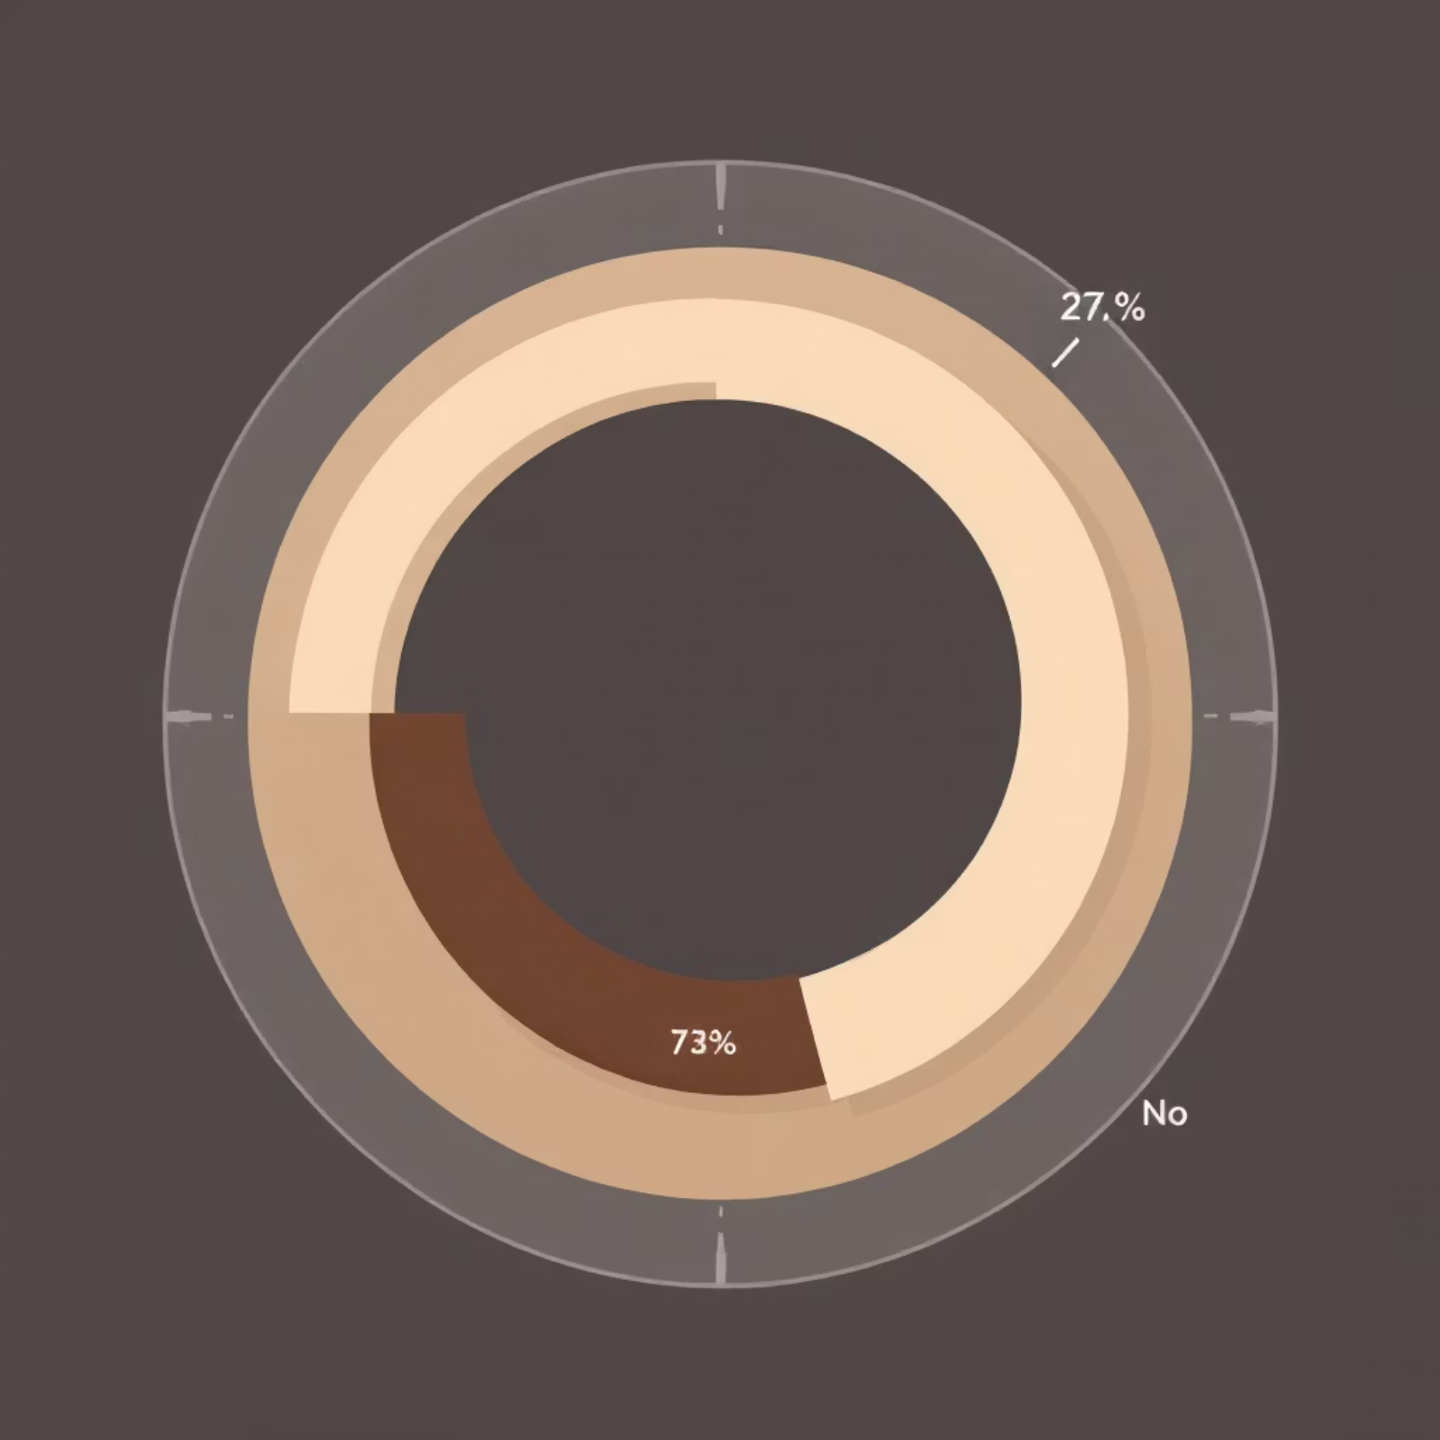
SQL Analysis - Age & Subscription
Repeat Buyers & Subscriptions
Customers with >5 purchases: 958 subscribers vs. 2518 non-subscribers.
Revenue by Age Group
Young Adult: $62,143
Middle-aged: $59,197
Adult: $55,978
Senior: $55,763

Slide 7

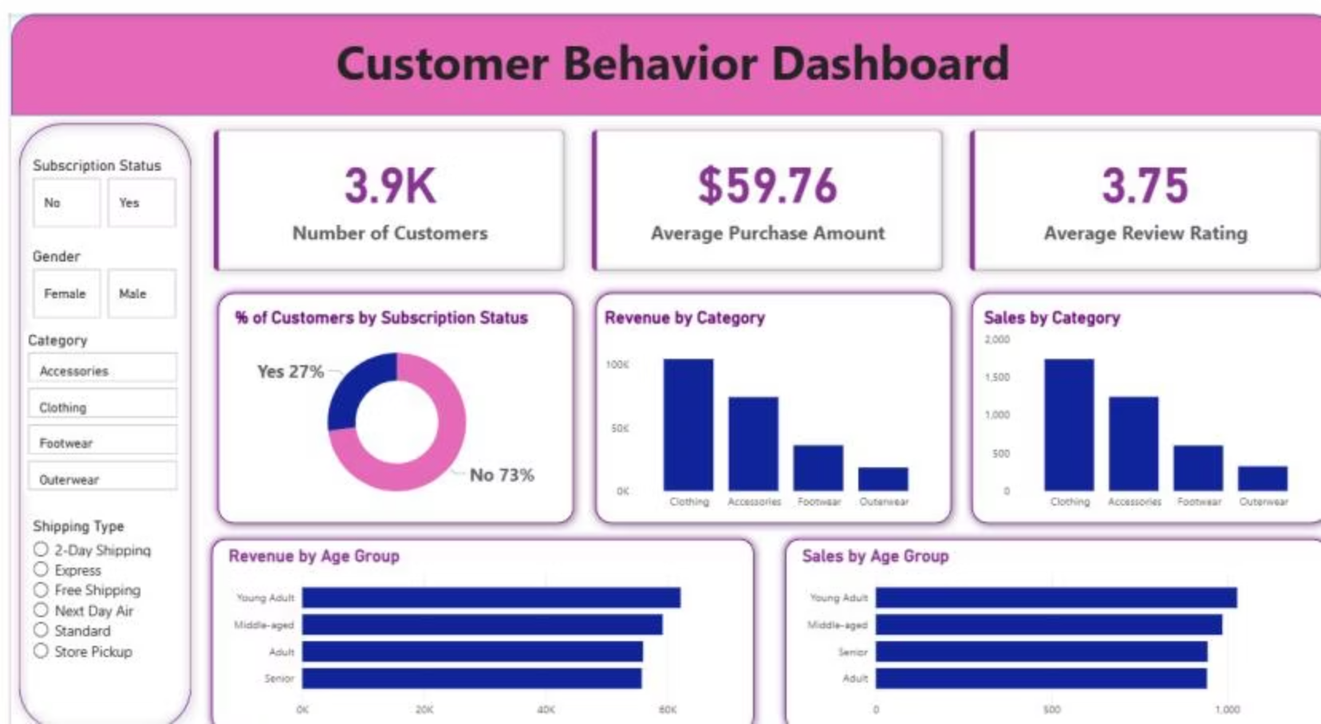
Interactive Power BI Dashboard
Visualizing key metrics: 3.9K customers, $59.76 avg. purchase, 3.75 avg. review rating.
Subscription Status
Revenue by Category
Revenue by Age Group
27% Yes, 73% No
Clothing: $100K, Accessories: $70K
Young Adult: $45K, Middle-aged: $40K

Slide 8





Business Recommendations
Boost Subscriptions
Promote exclusive benefits to increase subscriber base.
Customer Loyalty Programs
Reward repeat buyers to foster loyalty and retention.
Review Discount Policy
Balance sales boosts with healthy profit margins.
Product Positioning
Highlight top-rated and best-selling items in marketing campaigns.
Targeted Marketing
Focus efforts on high-revenue age groups and express-shipping users.

